Slide 1



Distinction between evolutionary scenarios using supervised machine learning
Pierrot Van der Aa
prionace96@gmail.com
Promotors : Patrick Mardulyn et Tom Lenaerts

Slide 2

Context
Gonioctena quinquepunctata
Evolutionary history from the Last Glacial Period
Present genetic variation
Phylogeography
Evolutionary history of geographical distribution

Slide 3
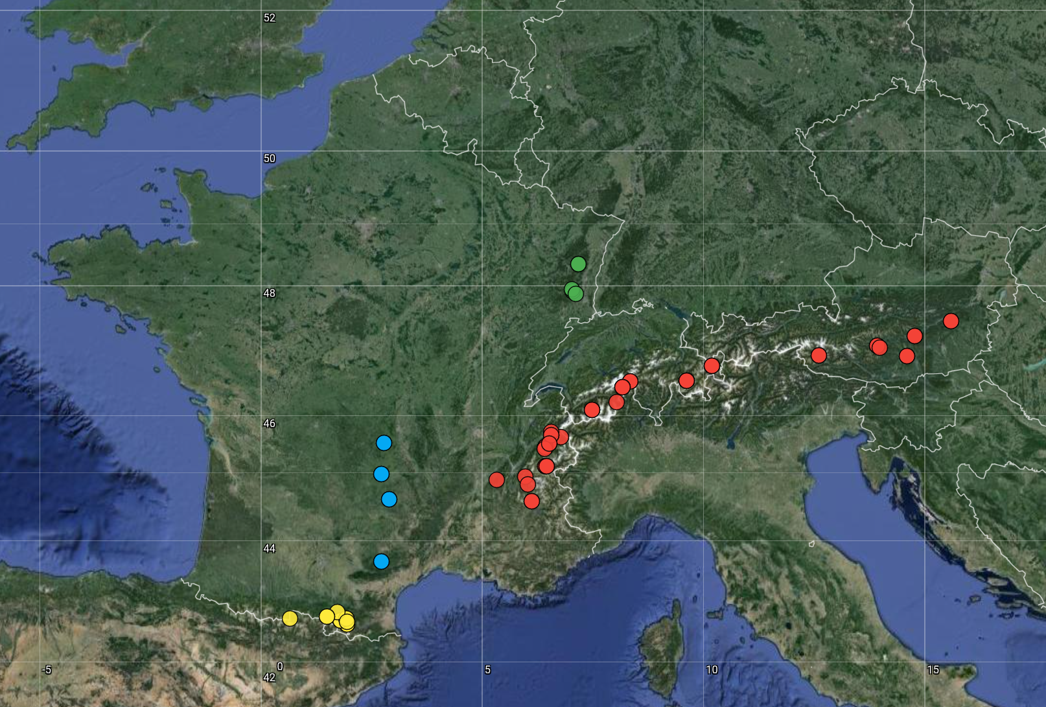
Why Gonioctena quinquepunctata ?
Gonioctena quinquepunctata
cold adapted species
fragmented distribution
Data collected:
reference genome
69 full genomes from Pyrenees, Massif Central, Alps and Vosges

Slide 4
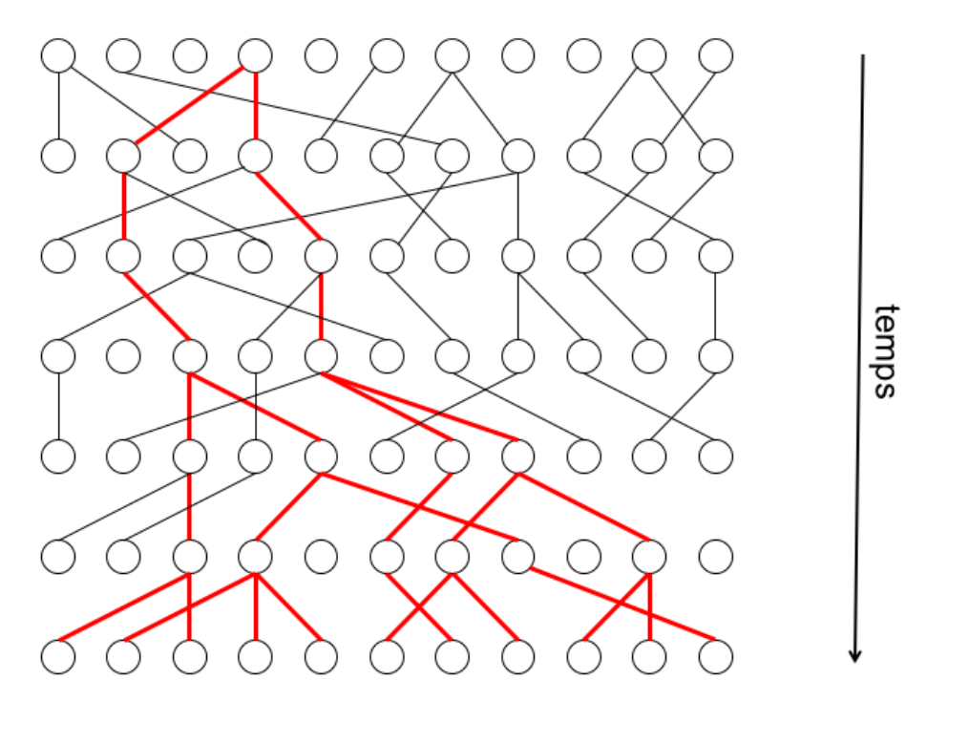
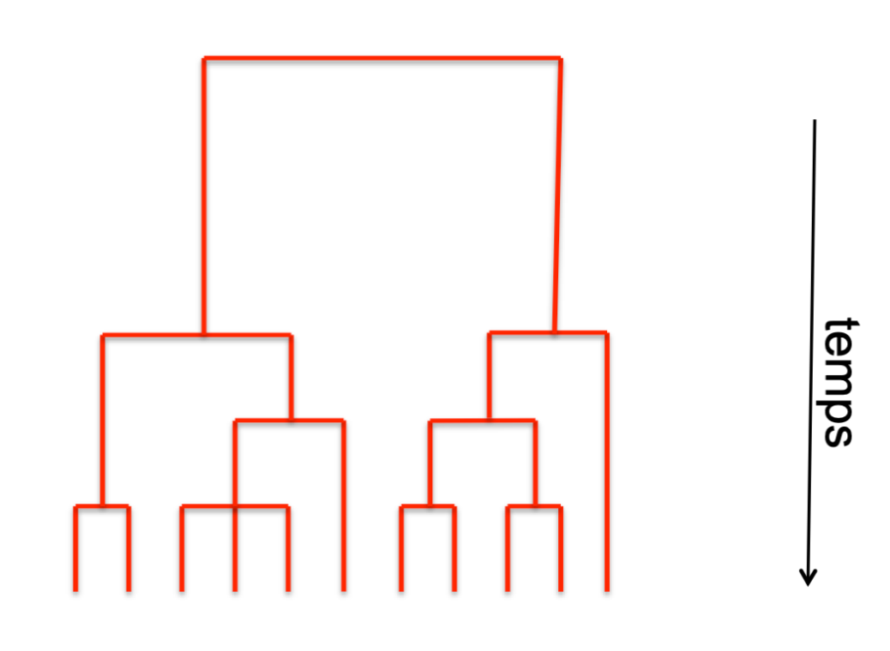
Modelling evolutionary history: the coalescent theory
time
= Most Recent Common Ancestor
Mardulyn (2024)
Notes:
Coalescent theory to make the bridge between evolutionary history and gene genealogies

Slide 5
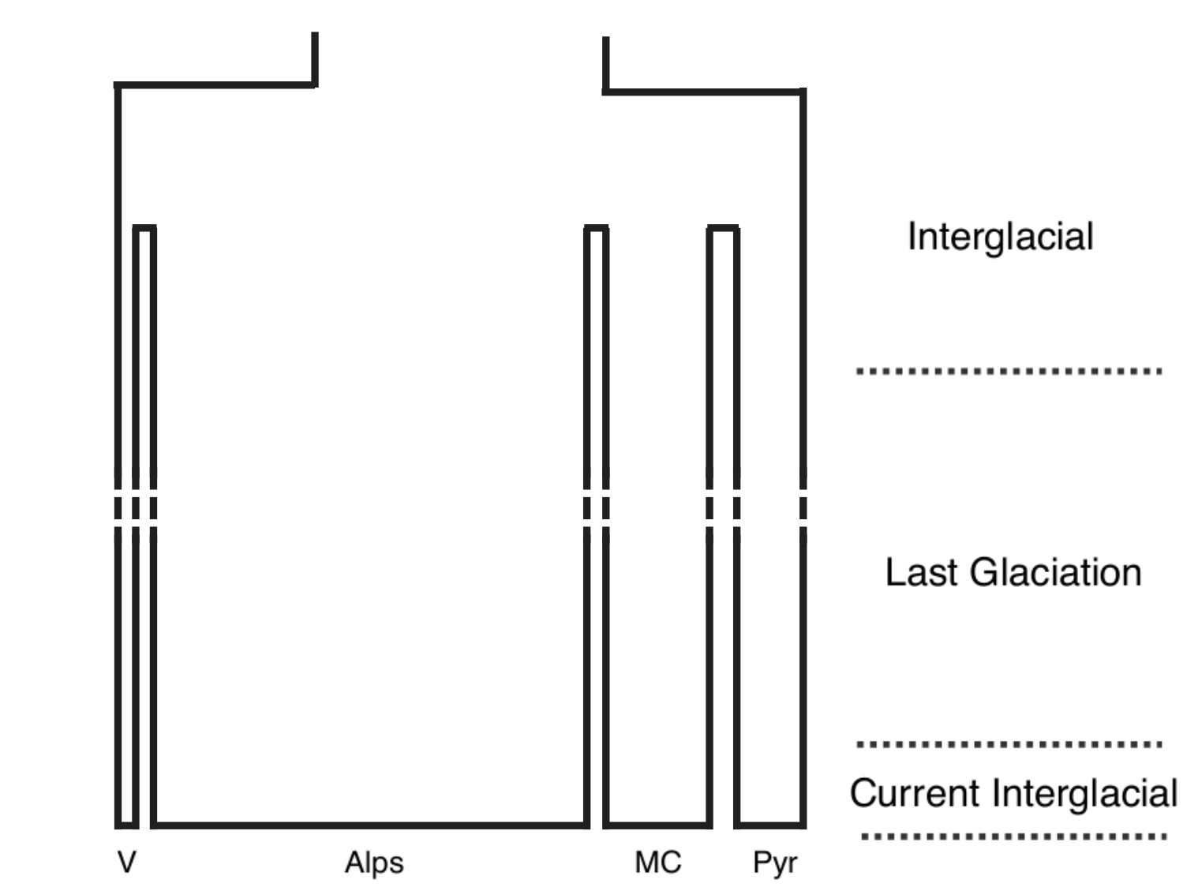
Graphical representation of an evolutionary scenario
code for the scenario
Hypothesis00
reduction in population size to allow for coalescence
Fragmentation
time
name of the scenario
populations at the present time

Slide 6
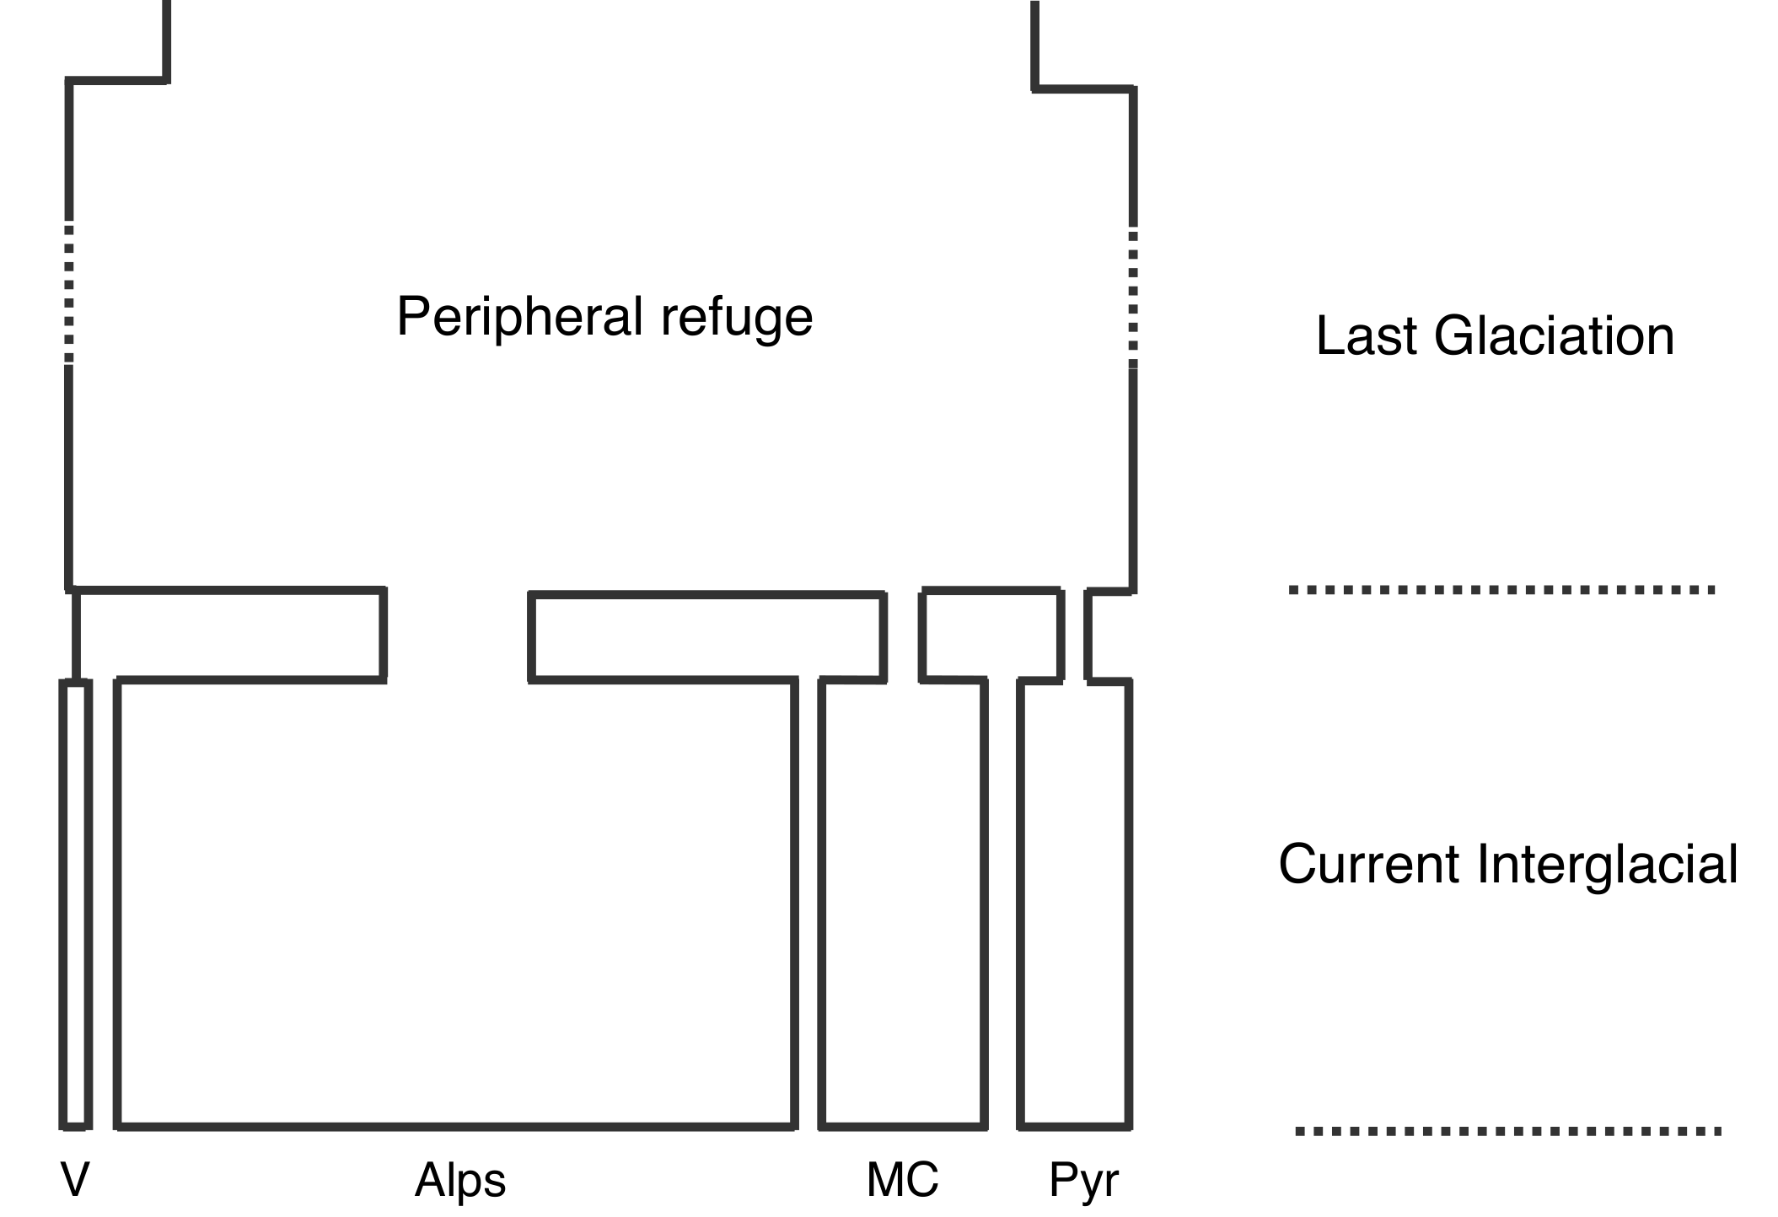
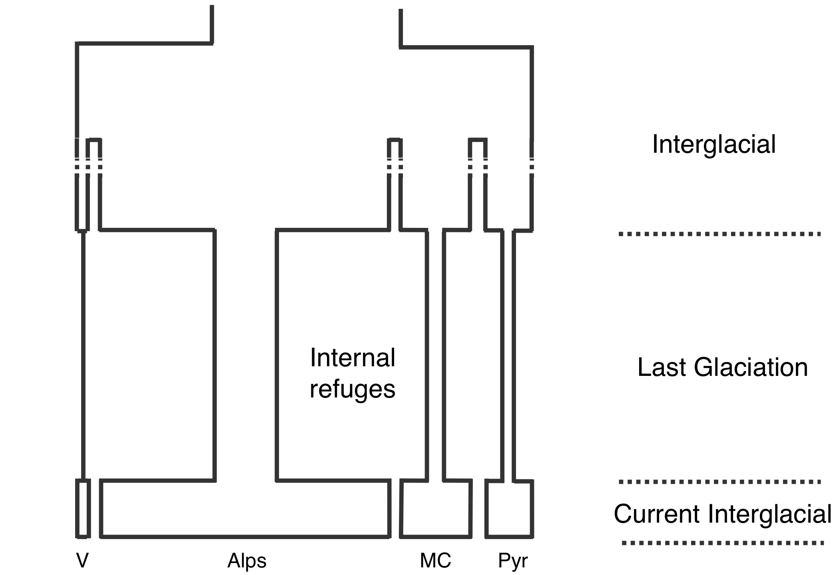
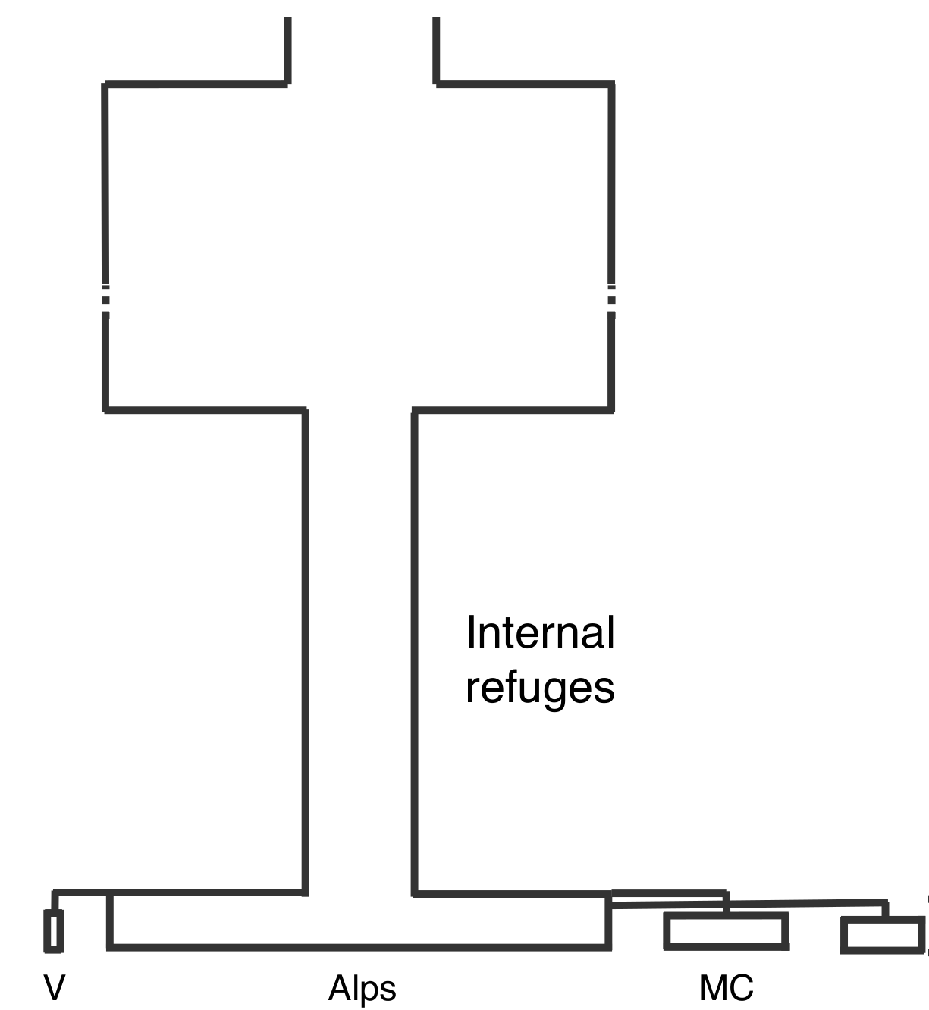
Hypothesis00
Hypothesis01
Fragmentation
Lowland refuge
Hypothesis02
Hypothesis03
Peripheral
refuge
Peripheral
refuge

Slide 7
Similar approaches
Approximate Bayesian Computation (ABC)
ABC-RF &
DIYABC Random Forest
Our approach
evolutionary scenarios
evolutionary scenarios
More flexible simulations with fastsimcoal
Hyperparameters tuning
Different ML algorithms
Simulation data
(100k to 1M)
Simulation data
(10k)
Selection of summary Statistics
Summary Statistics
Euclidian distance
Random forest
Pudlo et al. (2016)
Collin et al. (2021)

Slide 8
Goals
Can ML classifiers distinguish the different evolutionnary scenarios?
In which of the defined scenario does real life data fall into?
Gonioctena quinquepunctata

Slide 9






Pipeline
fastsimcoal2
conversion to .vcf
input files
summary statistics
supervised learning
comparison to
real life dataset

Slide 10
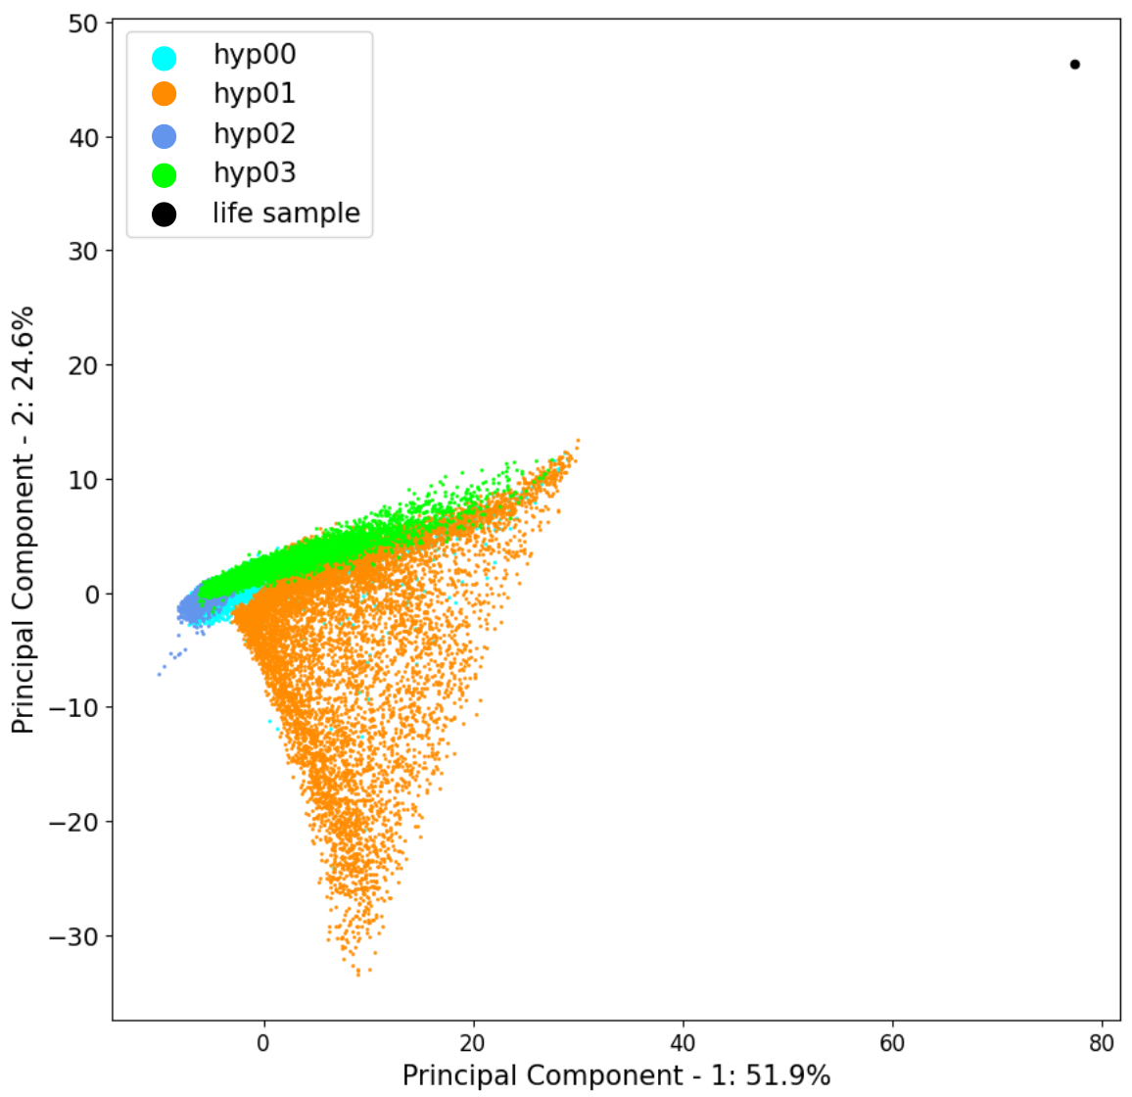
Data and ML task
40000 simulations of ~20000 independant SNPs each
Summarised by 84 features
Data is not linearly separable (logistic regression and PCA)
Multiclass supervised classification into 4 classes
Preprocessing: scaling of the data

Slide 11
Accuracy
Model | Before Hyperparameters Tuning
Logistic Regression | 0.795 ± 0.005
Decision Tree | 0.784 ± 0.004
Random Forest | 0.856 ± 0.003
Histogram-based Gradient Boosting Tree | 0.856 ± 0.004
After Hyperparameters Tuning
0.824 ± 0.004
0.832 ± 0.007
0.855 ± 0.004
0.856 ± 0.004

Slide 12
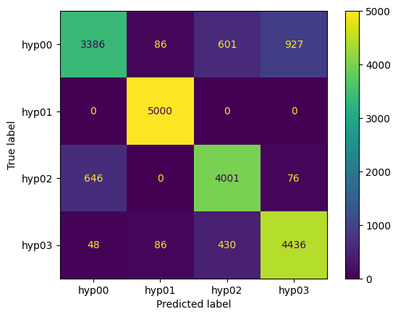
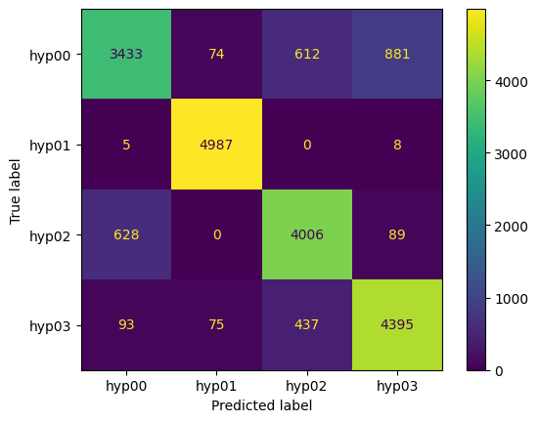
Confusion matrices
Random Forest
Histogram-based Gradient Boosting Tree

Slide 13
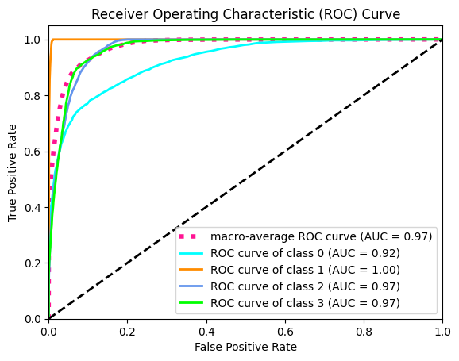
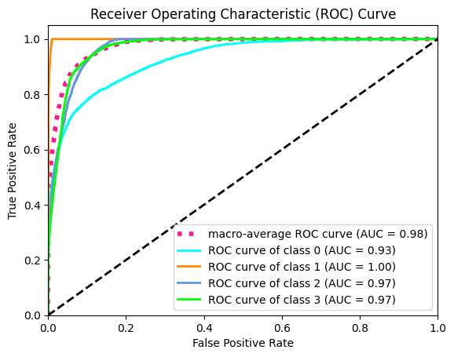
ROC curves
Random Forest
Histogram-based Gradient Boosting Tree

Slide 14
Computing time
 | Random Forest | Histogram-based Gradient Boosting Tree
First run | 1'36'' | 8''
Hyperparameters first run | 45'56'' | 18''
Hyperparameters second run | 43'30 | 2'19''
Validation | 3'49'' | 10''
Total [min] | 95’ | 3’
Time per run of hyperparameter search [s] | 10’’ | 0.6’’

Slide 15
Conclusion for the first goal
ML can be used to distinguish between evolutionary scenarios
Similar performances of HGBT compared to Random Forest
HGBT 17 times faster
Hyperparameter tuning seems unnecessary for random forest and HGBT

Slide 16
Life sample
Hypothesis01
Lowland refuge
 | Logistic regression | Decision tree | Random forest | HGBT
Hypothesis00 | 0% | 0% | 30.5% | 6.3%
Hypothesis01 | 0% | 100% | 32.4% | 73.0%
Hypothesis02 | 100% | 0% | 2.4% | 0.3%
Hypothesis03 | 0% | 0% | 34.8% | 20.5%
Hypothesis03
Peripheral
refuge

Slide 17
Conclusion for the second goal
Random forest predictions are unsure but align with previous genetic results
HGBT predictions are more clear and fit with species distribution models
Kastally et al. (submitted)

Slide 18
Thank you for your attention
Pierrot Van der Aa
prionace96@gmail.com
Promotors : Patrick Mardulyn et Tom Lenaerts

Slide 19
Other statistics
Random Forest
Histogram-based Gradient Boosting Tree
 | precision | recall | f1-score
Hypothesis00 | 0.83 | 0.68 | 0.75
Hypothesis01 | 0.97 | 1.00 | 0.98
Hypothesis02 | 0.80 | 0.85 | 0.82
Hypothesis03 | 0.82 | 0.89 | 0.85
 | precision | recall | f1-score
Hypothesis00 | 0.83 | 0.69 | 0.75
Hypothesis01 | 0.97 | 1.00 | 0.98
Hypothesis02 | 0.79 | 0.85 | 0.82
Hypothesis03 | 0.82 | 0.88 | 0.85

Slide 20
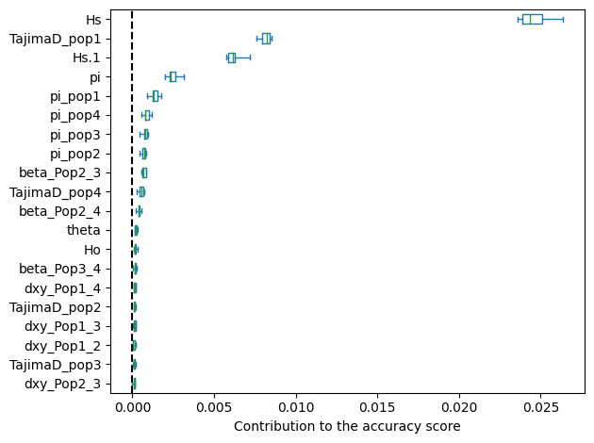
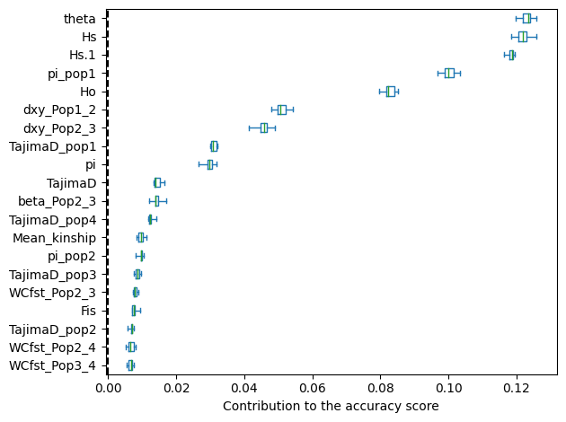
Permutation Importance
Random Forest
Histogram-based Gradient Boosting Tree

Slide 21
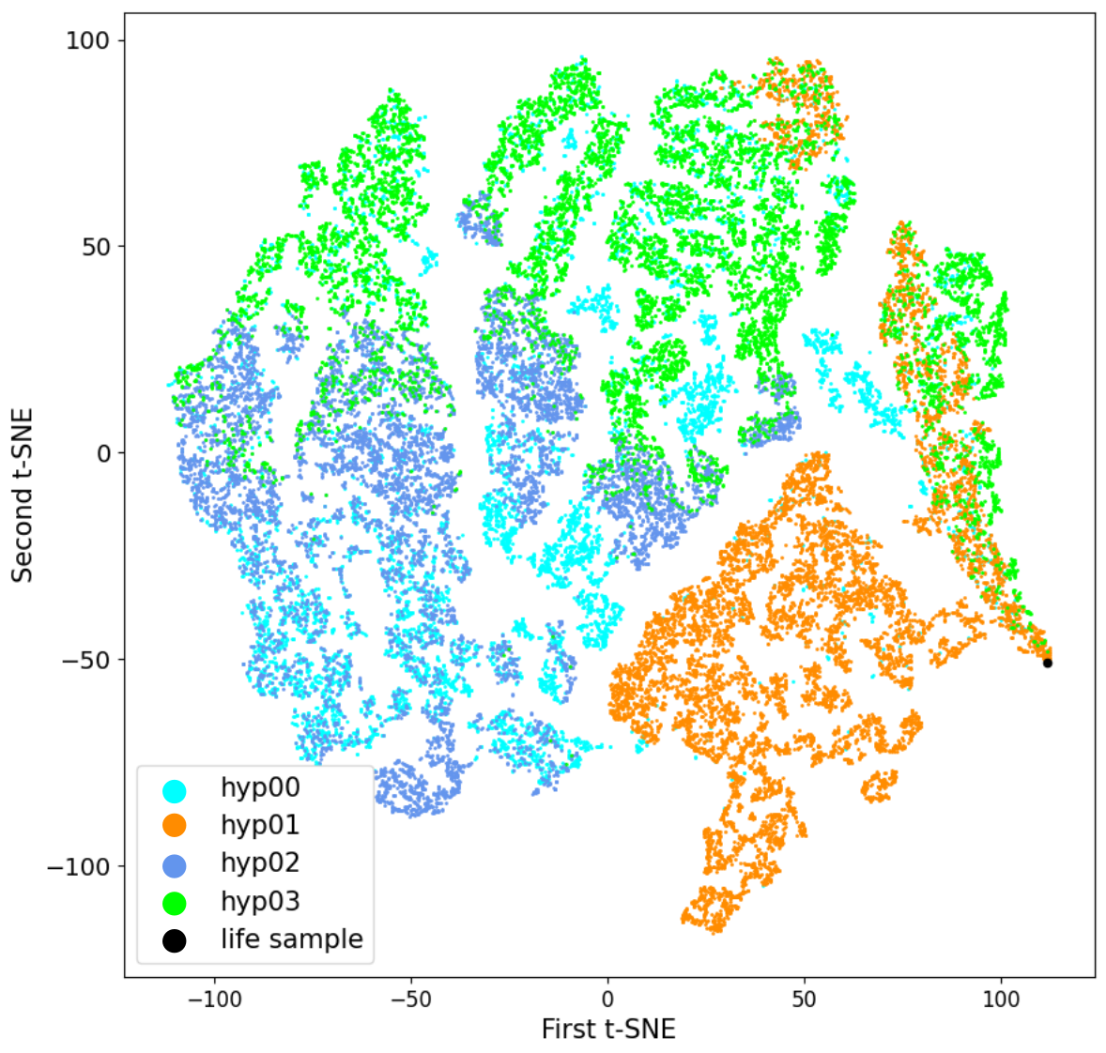
t-SNE

Slide 22
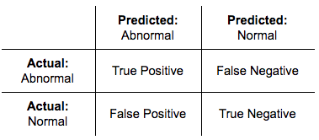
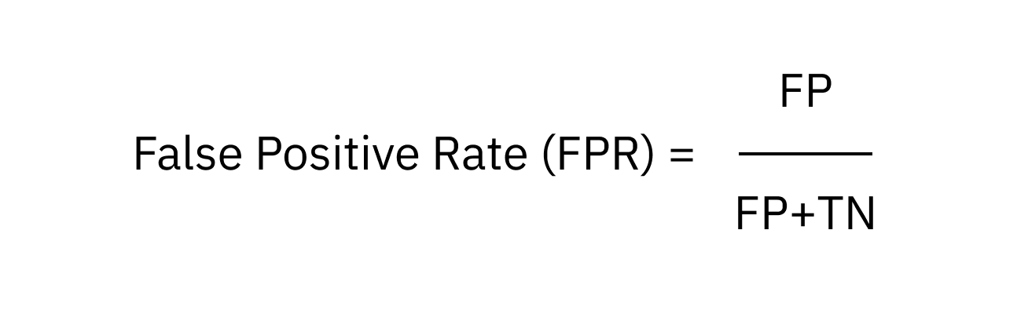
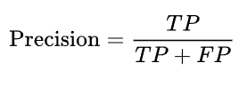
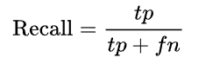
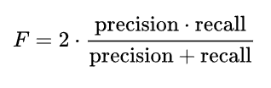
Supplementary: Equations
True positive rate = recall = sensitivity
False postitive rate
Precision: a high precision means that when the classifier predicts a positive class, it is likely to be right
Recall
f1-score

